Slide 1

Impact of Affordable Housing
on Local Communities
Group 2:
Anargha Ajoykumar
Anna Han
Thien-An Bui
Xiaojing Fang

Slide 2
CONTENTS
Introduction
Overview
Data Model
Dashboard
Takeaways

Slide 3
Executive Summary
Introduction
Overview
Data Model
Dashboard
Takeaways
Recommendations
Affordable housing has been a perpetual concern for local districts across the country, especially as shelter costs have become notoriously high. Integration is key to providing lower-income families with access to better resources such as grade-school public education, which is funded by local property taxes. However, residents tend to oppose affordable housing development in their locales for reasons such as fear of increased crime and “bad influences” around children. Policy leaders have acknowledged the necessity of understanding this tension to convince their voter base to work towards equity and safety for all.
With that in mind, our project bridges affordable housing developments and school incident records to better inform policymakers on the impacts of affordable housing. We construct key dashboards to deliver statistically driven guidance to stakeholders.

Slide 4
Data Sources
Introduction
Overview
Data Model
Dashboard
Takeaways
Recommendations
3 datasets obtained from the City of New York Open Data Repository:
Affordable Housing Production by Building Collected by Department of Housing Preservation and Development (HPD)
https://data.cityofnewyork.us/Housing-Development/Affordable-Housing-Production-by-Building/hg8x-zxpr
School Safety Reports collected by New York City Police Department (NYPD):
1. 2015- 2016: https://data.cityofnewyork.us/Education/2015-16-School-Safety-Report/44t3-dj6x
2. 2016- 2017: https://data.cityofnewyork.us/Education/2016-2017-School-Safety-Report/rear-wh5i

Slide 5
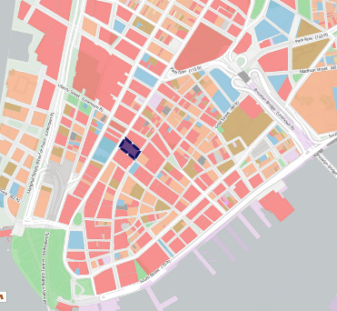
Business Use Case
Introduction
Overview
Data Model
Dashboard
Takeaways
NYC policy leaders have acknowledged the necessity of affordable housing to promote community well-being despite the pushback from some of their voter base due to fear of negative influences.
Our objective is to analyze the relationships between these two, particularly focused on pre-adult crime proxied by in-school incidents.
To policymakers our analysis provides insights to support (or deny) stereotypes, and data-based recommendations that can be used to sway the voter base.
To residents our database is a resource for deeper understanding of socio-economic dynamics in their local communities.
While our initial data sets are focused in New York City, our solution is built robustly to be applicable to data from any region.

Slide 6




Tools for Data Processing
Introduction
Overview
Data Model
Dashboard
Takeaways
ETL Processing
Excel, SQL Workbench
SQL Workbench
Modeling, Analysis
Visualizations
Tableau
Powerpoint
Reporting

Slide 7
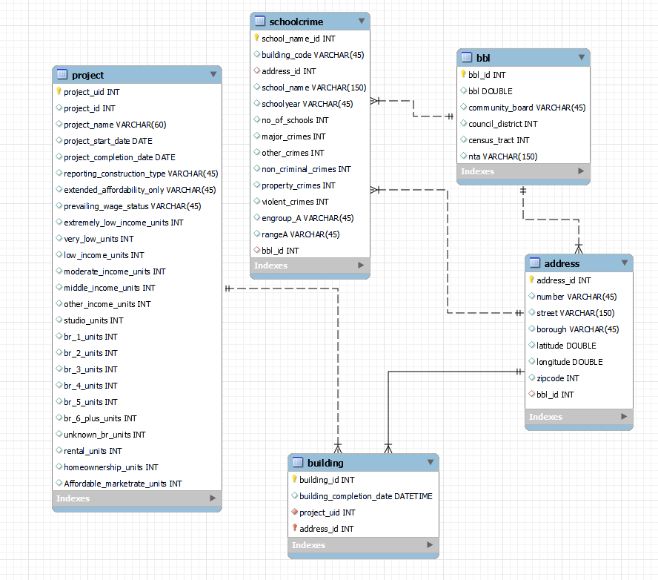
Enhanced Entity
Relationship
Model
Introduction
Overview
Data Model
Dashboard
Takeaways

Slide 8
Model Details
Introduction
Overview
Data Model
Dashboard
Takeaways
Parameters | CARDINALITY | DETAILS
Project | 1 : M with Building | Affordable housing project specifics.
Building | M : 1 with Address | Building(s) within purview of each project.
Address | M : 1 with BBL | Unique addresses of involved buildings.
BBL | 1: M with School Crime | District constituency key to stakeholders.
School Crime | M : 1 with BBL M : 1 with Address | Crime data for incidents occurring in public schools.

Slide 9
Design Considerations
Introduction
Introduction
Overview
Overview
Data Model
Data Model
Takeaways
Dashboard
Recommendations
Takeaways
Our database design is centered on developmental projects. We add information based on location to serve contextually relevant stakeholders.
Removed fields (e.g., BIN, all_counted_units) exhibiting uninformative autocorrelation to reduce complexity, and mitigate input errors and future scrubbing.
Omitted “CONFIDENTIAL” projects for which data was limited.
Borough-Block-Lot (BBL) is a unique table from Address as it contains official districting information determined by local politics but not housing projects.
BBL is found in various datasets thus increasing flexibility of this database to be expanded for broader business purposes.

Slide 10
Data Loading Challenges & Solutions
Introduction
Introduction
Overview
Overview
Data Model
Data Model
Takeaways
Dashboard
Recommendations
Takeaways
Loading data from the raw CSV file to the MySQL Workbench environment proved challenging, resulting in errors or partial record loading.
Manually removed special characters and imported via Workbench's import wizard.
1
Handling raw data from multiple files posed challenges, particularly in avoiding duplicates during loading, for lookup tables like addresses and bbl.
Added UNIQUE constraint to address and bbl and used the ‘INSERT IGNORE INTO’ command.
2
Identifying a primary key for each table and determining a unique lookup field proved challenging in this context.
Concatenated multiple fields to obtain the primary key and look-up fields.
3

Slide 11
Data Analysis Sample: MySQL queries
Introduction
Introduction
Overview
Overview
Data Model
Data Model
Takeaways
Dashboard
Recommendations
Takeaways
Borough-level information for incoming non-local residents
Council District level information for local politicians
Project cyclicality
Housing vs. Crime for local, new residents and policymakers
* New York City Borough > Community Board = Council District > Neighborhood Tabulation Areas (NTAs) > Census Tract

Slide 12
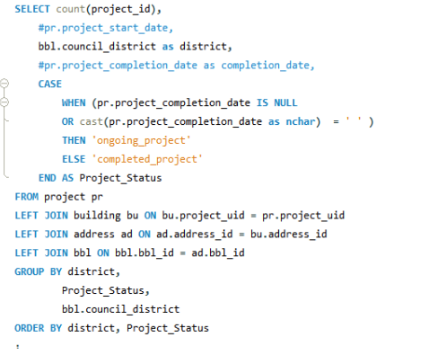
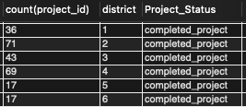
Data Analysis Sample: MySQL queries
Introduction
Overview
Data Model
Dashboard
Takeaways
Input Query
Output

Slide 13
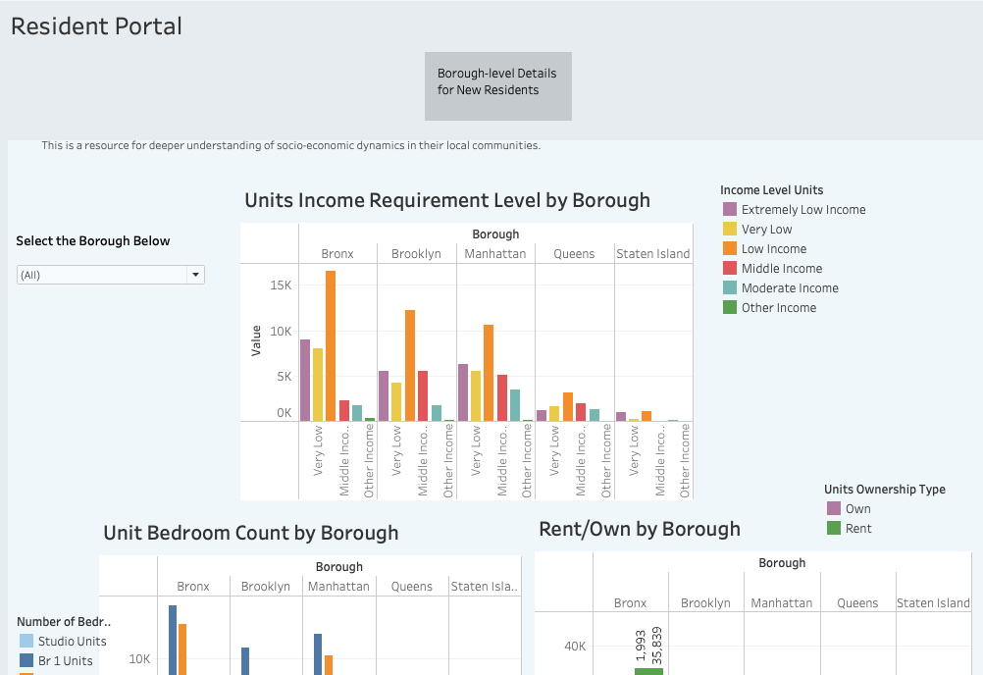
Dashboard:
Introduction
Overview
Data Model
Dashboard
Takeaways
Resident Portal

Slide 14
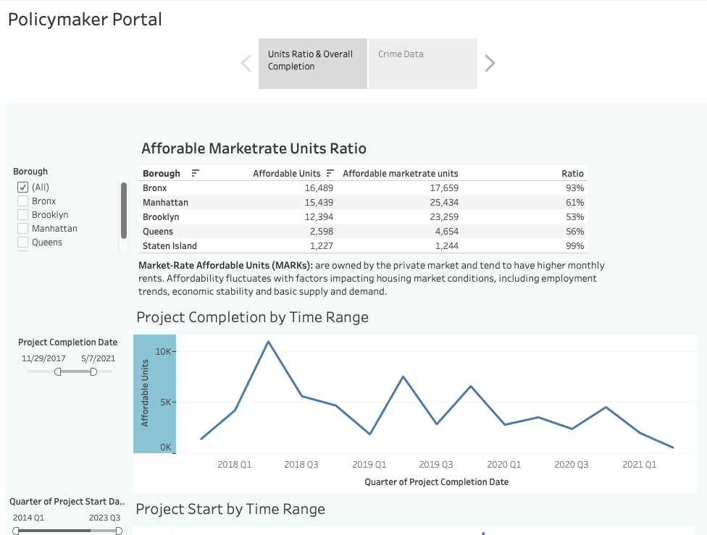
Dashboard:
Introduction
Overview
Data Model
Dashboard
Takeaways
Introduction
Overview
Data Model
Takeaways
Recommendations
Policymaker Portal

Slide 15
Introduction
Overview
Data Model
Dashboard
Takeaways
Recommendations
Affordable housing tends to be isolated in the Bronx and Staten Island vs. integrated in Brooklyn, Manhattan, and Queens.
Project initiation has a cyclical impact on labor markets – specifically construction unions.
Affordable housing did not correlate with increased adolescent crime.

Slide 16
Introduction
Overview
Data Model
Dashboard
Takeaways
Lessons Learned
KYC → KYD: Know Your Data.
Multi-step queries through temporary tables.
Prioritize business goals.

Slide 17
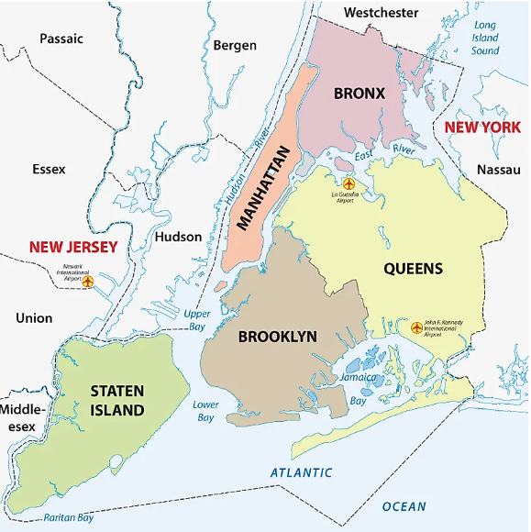
Thank You!

